Slide 1

Dynamic Programming
Dynamic Programming
Notes:
Dynamic Programming

Slide 2

Outline and Reading
Matrix Chain-Product (§5.3.1)
The General Technique (§5.3.2)
0-1 Knapsack Problem (§5.3.3)
Dynamic Programming

Slide 3

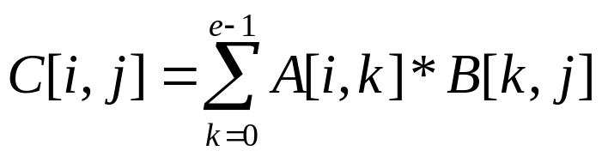
Matrix Chain-Products
Dynamic Programming is a general algorithm design paradigm.
  Rather than give the general structure, let us first give a motivating example:
  Matrix Chain-Products
Review: Matrix Multiplication.
  C = A*B
  A is d × e and B is e × f
  O(d⋅e⋅f ) time
f
B
j
e
e
A
C
d
i
i,j
d
f
Dynamic Programming

Slide 4
Matrix Chain-Products
Matrix Chain-Product:
  Compute A=A₀*A₁*…*A_{n-1}
  A_{i} is d_{i} × d_{i+1}
  Problem: How to parenthesize?
Example
  B is 3 × 100
  C is 100 × 5
  D is 5 × 5
  (B*C)*D takes …
  B*(C*D) takes ….
Dynamic Programming

Slide 5
Matrix Chain-Products
Matrix Chain-Product:
  Compute A=A₀*A₁*…*A_{n-1}
  A_{i} is d_{i} × d_{i+1}
  Problem: How to parenthesize?
Example
  B is 3 × 100
  C is 100 × 5
  D is 5 × 5
  (B*C)*D takes 1500 + 75 = 1575 ops
  B*(C*D) takes 1500 + 2500 = 4000 ops
Dynamic Programming

Slide 6
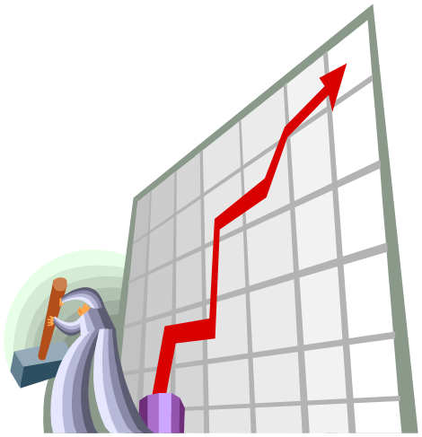
Enumeration Approach
Matrix Chain-Product Alg.:
  Try all possible ways to parenthesize A=A₀*A₁*…*A_{n-1}
  Calculate number of ops for each one
  Pick the one that is best
Running time:
  The number of parenthesizations is equal to the number of binary trees with n nodes
  This is exponential!
  It is called the Catalan number, and it is almost 4^{n}.
  This is a terrible algorithm!
Dynamic Programming

Slide 7

Greedy Approach
Idea #1: repeatedly select the product that uses (up) the most operations.
Counter-example:
  A is 10 × 5
  B is 5 × 10
  C is 10 × 5
  D is 5 × 10
  Greedy idea #1 gives (A*B)*(C*D), which takes 500+1000+500 = 2000 ops
  A*((B*C)*D) takes 500+250+250 = 1000 ops
Dynamic Programming

Slide 8
Another Greedy Approach
Idea #2: repeatedly select the product that uses the fewest operations.
Counter-example:
  A is 101 × 11
  B is 11 × 9
  C is 9 × 100
  D is 100 × 99
  Greedy idea #2 gives A*((B*C)*D)), which takes 109989+9900+108900=228789 ops
  (A*B)*(C*D) takes 9999+89991+89100=189090 ops
The greedy approach is not giving us the optimal value.
Dynamic Programming

Slide 9

“Recursive” Approach
Define subproblems:
  Find the best parenthesization of A_{i}*A_{i+1}*…*A_{j}.
  Let N_{i,j} denote the number of operations done by this subproblem.
  The optimal solution for the whole problem is N_{0,n-1}.
Subproblem optimality: The optimal solution can be defined in terms of optimal subproblems
  There has to be a final multiplication (root of the expression tree) for the optimal solution.
  Say, the final multiply is at index i: (A₀*…*A_{i})*(A_{i+1}*…*A_{n-1}).
  Then the optimal solution N_{0,n-1} is the sum of two optimal subproblems, N_{0,i} and N_{i+1,n-1} plus the time for the last multiply.
  If the global optimum did not have these optimal subproblems, we could define an even better “optimal” solution.
Dynamic Programming

Slide 10

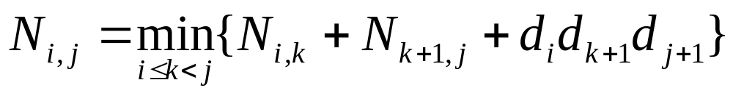
Characterizing Equation
The global optimal has to be defined in terms of optimal subproblems, depending on where the final multiply is at.
Let us consider all possible places for that final multiply:
  Recall that A_{i} is a d_{i} × d_{i+1} dimensional matrix.
  So, a characterizing equation for N_{i,j} is the following:
Note that subproblems are not independent–the subproblems overlap.
Dynamic Programming

Slide 11

Dynamic Programming Algorithm Visualization
The bottom-up construction fills in the N array by diagonals
N_{i,j} gets values from previous entries in i-th row and j-th column
Filling in each entry in the N table takes O(n) time.
Total run time: O(n³)
Getting actual parenthesization can be done by remembering “k” for each N entry
N
0
1
2
i
j
…
n-1
0
1
…
answer
i
j
n-1
Dynamic Programming

Slide 12
Dynamic Programming Algorithm
Since subproblems overlap, we don’t use recursion.
Instead, we construct optimal subproblems “bottom-up.”
N_{i,i}’s are easy, so start with them
Then do problems of “length” 2,3,… subproblems, and so on.
Running time: O(n³)
Algorithm matrixChain(S):
Input: sequence S of n matrices to be multiplied
Output: number of operations in an optimal parenthesization of S
  for i ← 1 to n − 1 do
  N_{i,i} ← 0
  for b ← 1 to n − 1 do
  { b = j − i is the length of the problem }
  for i ← 0 to n − b − 1 do
  j ← i + b
  N_{i,j} ← +∞
  for k ← i to j − 1 do
  N_{i,j} ← min{N_{i,j}, N_{i,k} + N_{k+1,j} + d_{i} d_{k+1} d_{j+1}}
  return N_{0,n−1}
Dynamic Programming

Slide 13

The General Dynamic Programming Technique
Applies to a problem that at first seems to require a lot of time (possibly exponential), provided we have:
  Simple subproblems: the subproblems can be defined in terms of a few variables, such as j, k, l, m, and so on.
  Subproblem optimality: the global optimum value can be defined in terms of optimal subproblems
  Subproblem overlap: the subproblems are not independent, but instead they overlap (hence, should be constructed bottom-up).
Dynamic Programming

Slide 14


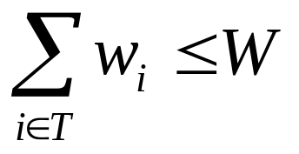
The 0/1 Knapsack Problem
Given: A set S of n items, with each item i having
  w_{i} - a positive weight
  b_{i} - a positive benefit
Goal: Choose items with maximum total benefit but with weight at most W.
If we are not allowed to take fractional amounts, then this is the 0/1 knapsack problem.
  In this case, we let T denote the set of items we take
  Objective: maximize
  Constraint:
Dynamic Programming

Slide 15

Example
Given: A set S of n items, with each item i having
  b_{i} - a positive “benefit”
  w_{i} - a positive “weight”
Goal: Choose items with maximum total benefit but with weight at most W.
“knapsack”
Items:
1
2
3
4
5
box of width 9 in
Weight:
Solution:
item 5 ($80, 2 in)
item 3 ($6, 2in)
item 1 ($20, 4in)
4 in
2 in
2 in
6 in
2 in
Benefit:
$20
$3
$6
$25
$80
Dynamic Programming
Notes:
Dynamic Programming

Slide 16
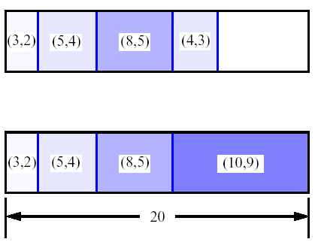
A 0/1 Knapsack Algorithm, First Attempt
S_{k}: Set of items numbered 1 to k.
Define B[k] = best selection from S_{k}.
Problem: does not have subproblem optimality:
  Consider set S={(3,2),(5,4),(8,5),(4,3),(10,9)} of
  (benefit, weight) pairs and total weight W = 20
Best for S₄:
Best for S₅:
Dynamic Programming

Slide 17
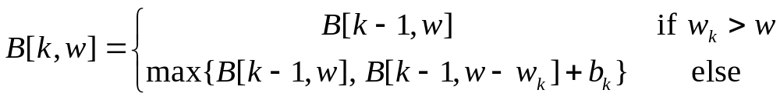
A 0/1 Knapsack Algorithm, Second Attempt
S_{k}: Set of items numbered 1 to k.
Define B[k,w] to be the best selection from S_{k} with weight at most w
Good news: this does have subproblem optimality.
I.e., the best subset of S_{k} with weight at most w is either
  the best subset of S_{k-1} with weight at most w or
  the best subset of S_{k-1} with weight at most w−w_{k} plus item k
Dynamic Programming

Slide 18
0/1 Knapsack Algorithm
Algorithm 01Knapsack(S, W):
Input: set S of n items with benefit b_{i} and weight w_{i}; maximum weight W
Output: benefit of best subset of S with weight at most W
let A and B be arrays of length W + 1
for w ← 0 to W do
  B[w] ← 0
  for k ← 1 to n do
  copy array B into array A
  for w ← w_{k} to W do
  if A[w−w_{k}] + b_{k} > A[w] then
  B[w] ← A[w−w_{k}] + b_{k}
  return B[W]
Recall the definition of B[k,w]
Since B[k,w] is defined in terms of B[k−1,*], we can use two arrays of instead of a matrix
Running time: O(nW).
Not a polynomial-time algorithm since W may be large
This is a pseudo-polynomial time algorithm
Dynamic Programming

